Slide 1
Steam: What’s your Game
Jason Chiu

Slide 2
Overview
Steam
Research Question
Data
Preliminary Findings
Conclusion and Future Direction

Slide 3
Steam
Leading digital distribution platform
Services
Game purchase/management
Cloud saving
Multiplayer gaming
Social Networking
6 Million active users in the U.S.
Gender Gap

Slide 4
Research Question
Game
Voluntary participation
~ 60,000 games (free and priced games)
Research Question:
Among the top selling games on Steam, what are some of the characteristics that are associated with higher numbers of players?

Slide 5
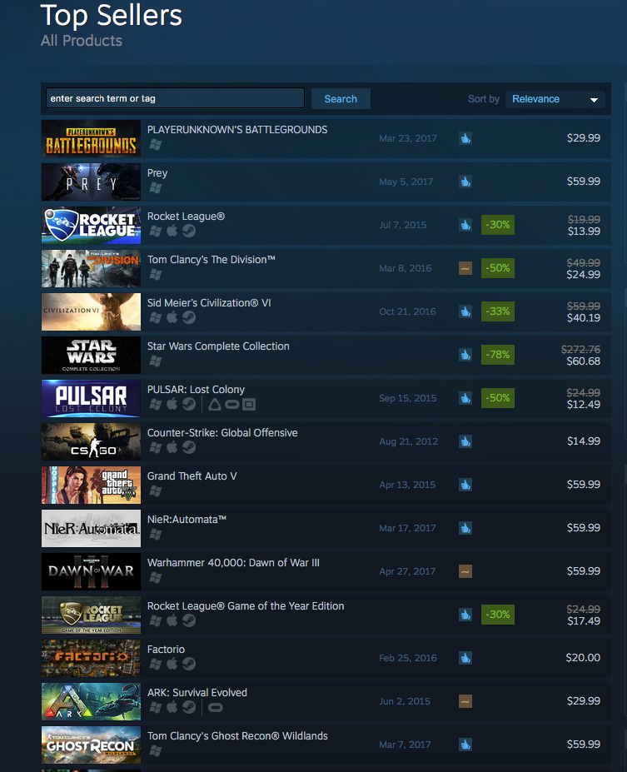
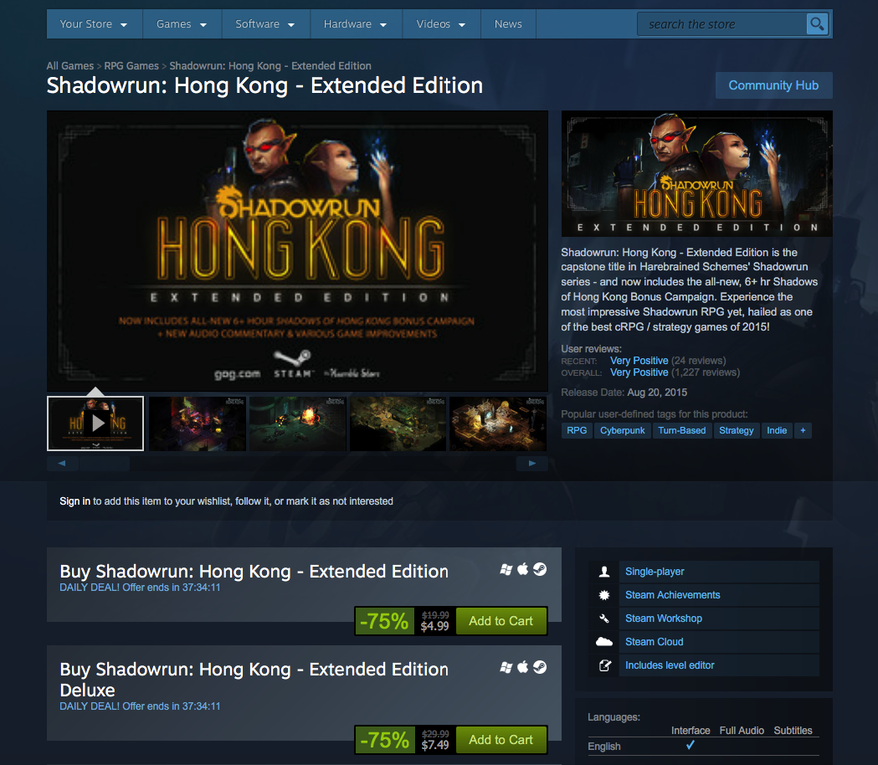
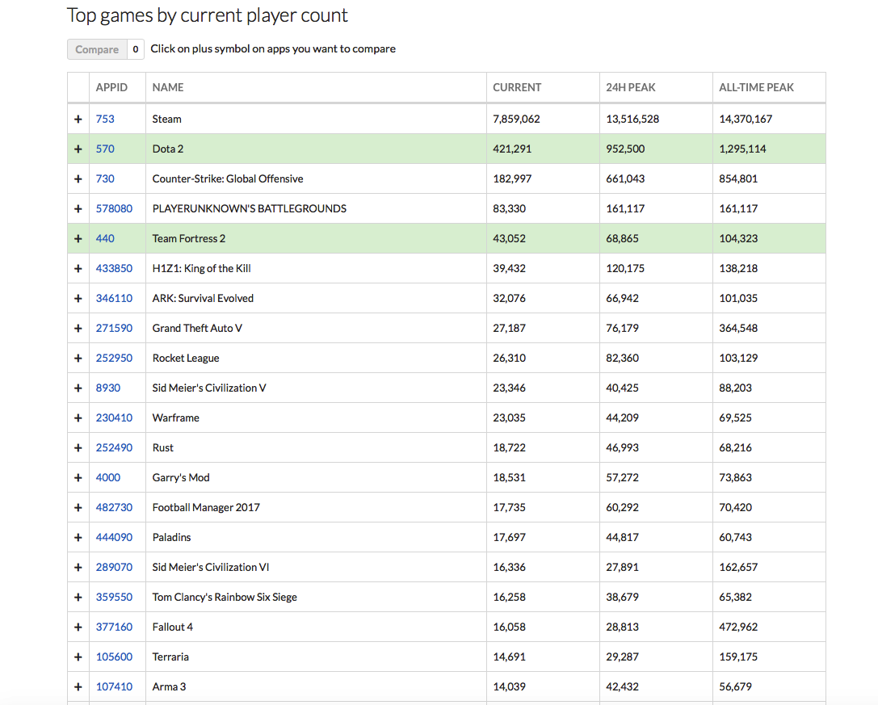
Data - Selenium and Scrapy
Steam Top Sellers
Price/title
Steam Game Page
Game specs
Steamdb.info
No. of players

Slide 6
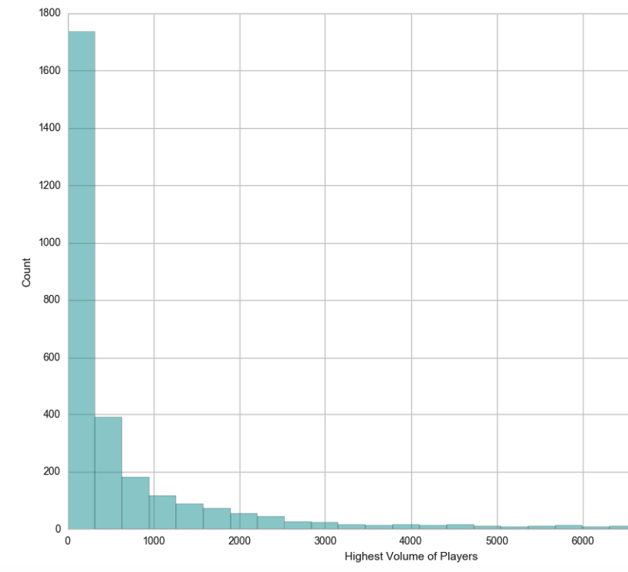
Highest Volume of Players
Mean: 2853
The largest number of players playing the game simultaneously after the game was released
Top 5 games:
Title | All Time High
Fallout 4 | 472,962
Grand Theft Auto V | 364,548
No Man's Sky | 212,613
Sid Meiers Civilization VI | 162,657
Left 4 Dead 2 | 162163
Long right tail

Slide 7
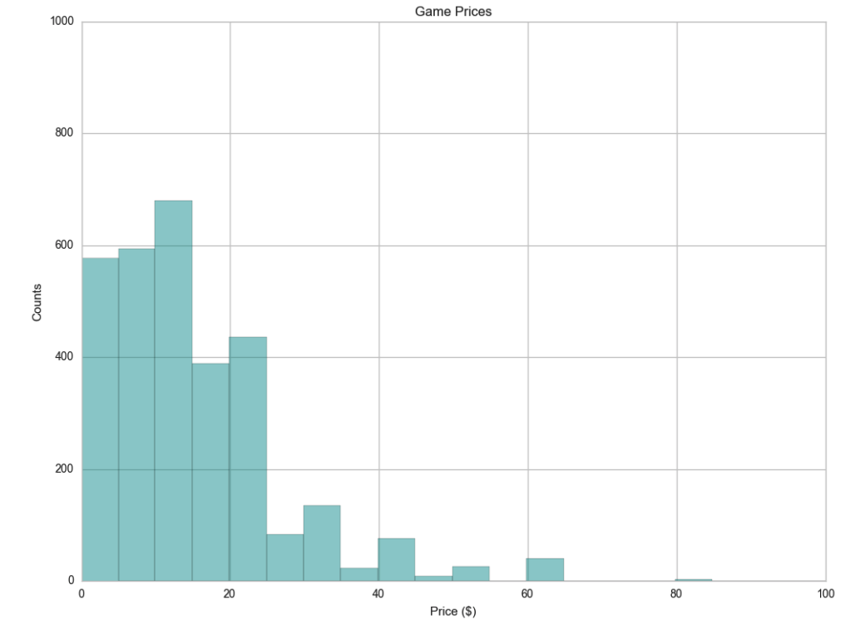
Basic Demographics
Released Year
Pricing
The top selling list is very reactive
Mean: $13.68

Slide 8
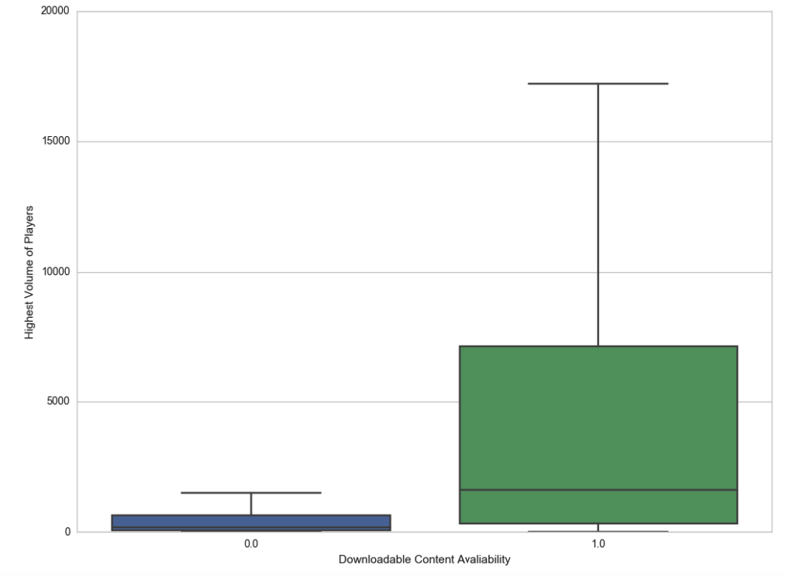
Downloadable Content
Additional content created for a released game
Only ~ 15% of the games have downloadable content (avg. 1)
It is significantly associated with an increased in the maximum number of players

Slide 9
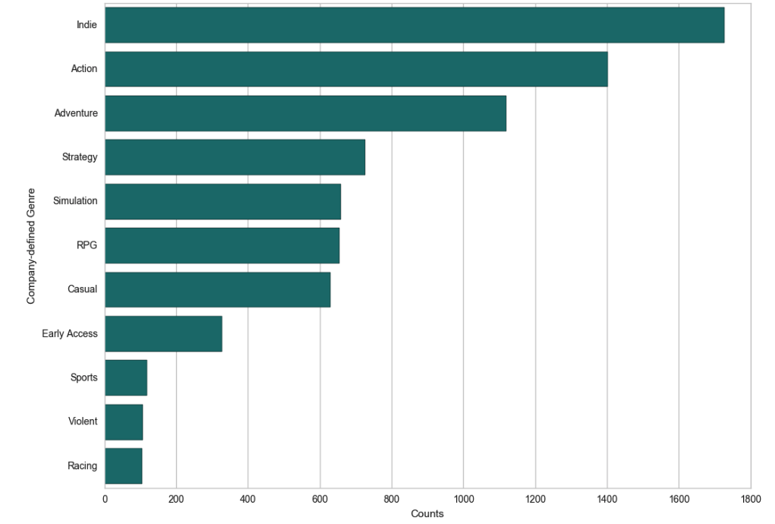
Genre

Slide 10
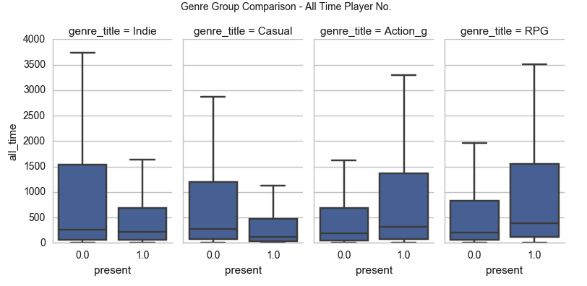
Genre & Players

Slide 11
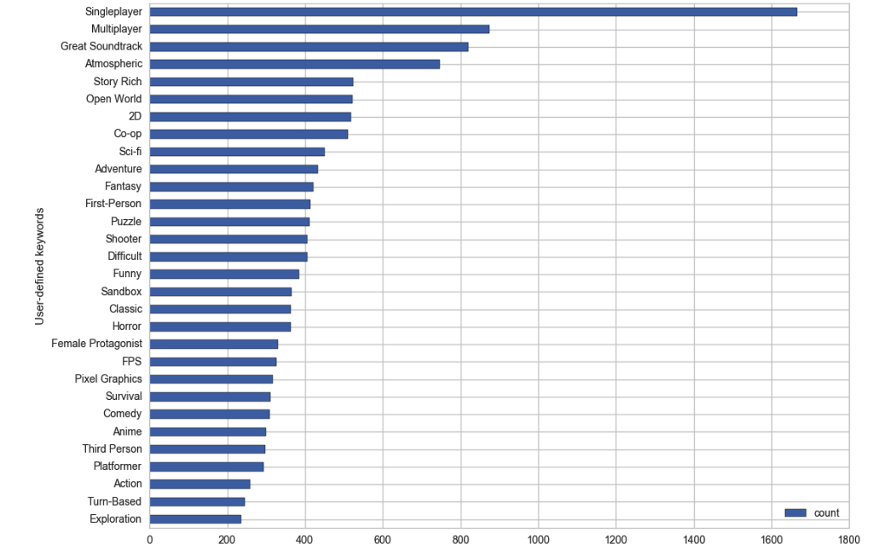
User-defined Keywords

Slide 12
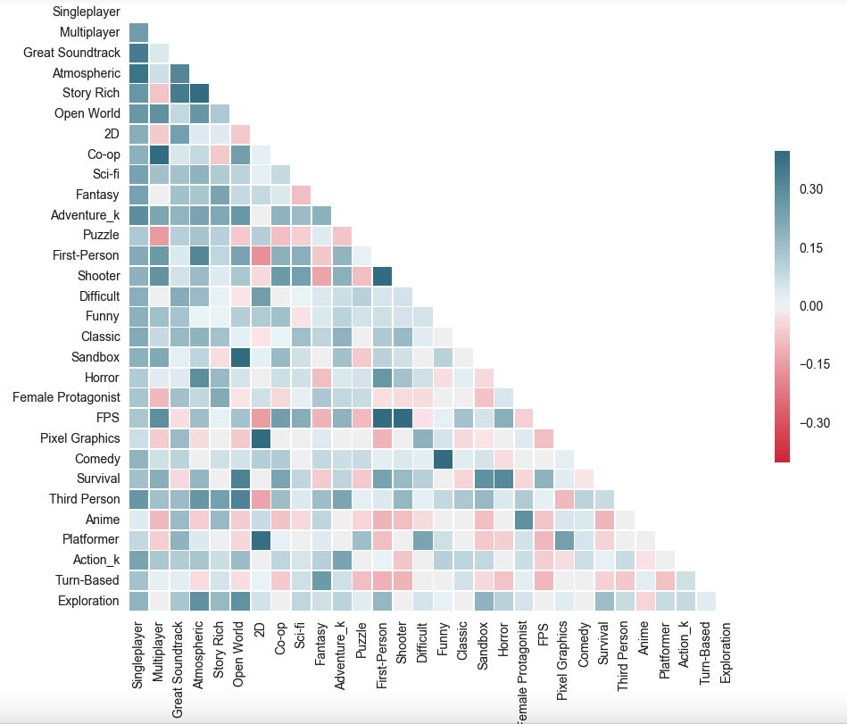
Immersive
Open World
FPS = first person + shooter

Slide 13
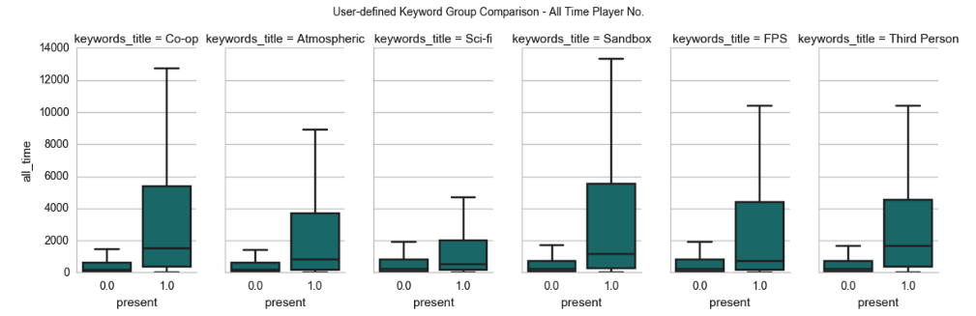
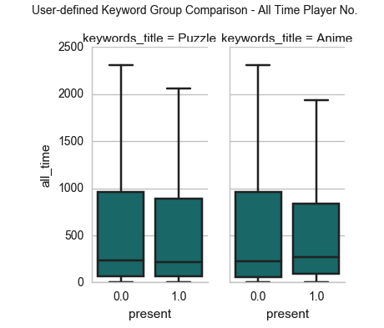
Association
Positive
Negative
Multiplayer/Co-op
Immersive Experience
Sci-fi Theme
Sandbox Design
First Person Shooter
Third Person
Puzzle
Anime

Slide 14
Conclusion and Future Direction
The highest volume of players is associated with dlcs, genres, and keywords
Future Direction:
Further understand the relationship between keywords and genre
Player retention: compare current number of players with the highest volume of players
Players characteristics
Implications:
Understand what players are looking for

Slide 15
Thank you!
Any Questions?

